Slide 1

Predicting Income Level Using Census Data
Tanmay Gandhi

Slide 2

Introducing Census Data
Census data provides extensive information about a population:
Age
Education
Work class
Marital status
Occupation
Race
Gender
Capital gains/losses
Hours per week
Country of origin

Slide 3
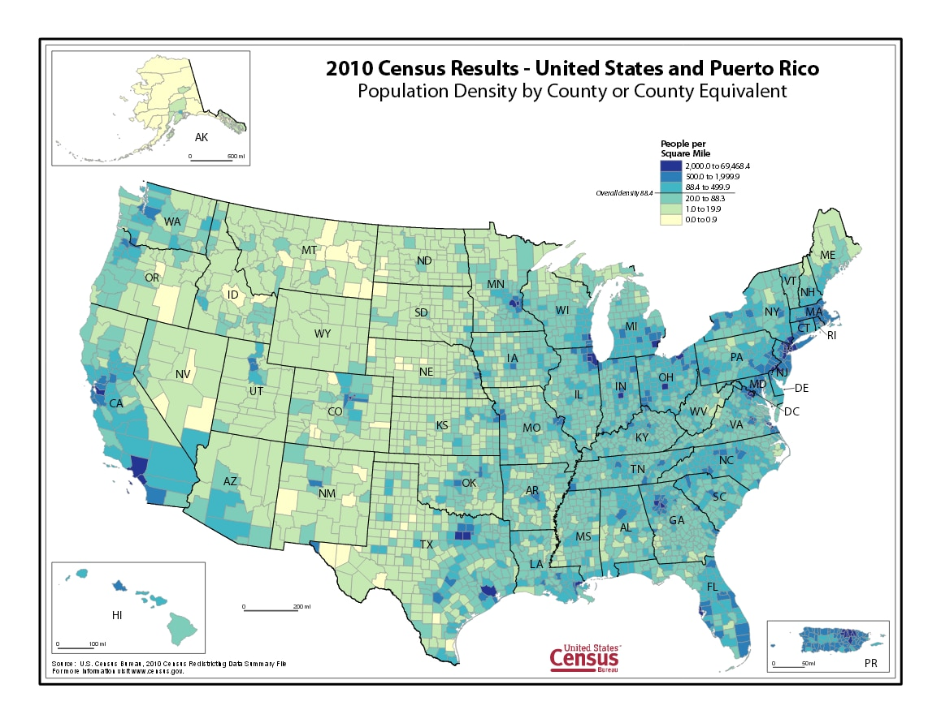
Why Census Data Matters
Policy Making: Guides resource allocation and social programs.
Business Insights: Enables companies to tailor products to specific demographic groups.
Socioeconomic Studies: Reveals trends in income, education, and employment.
ML Applications: Predicting income helps identify disparities and possible interventions.

Slide 4
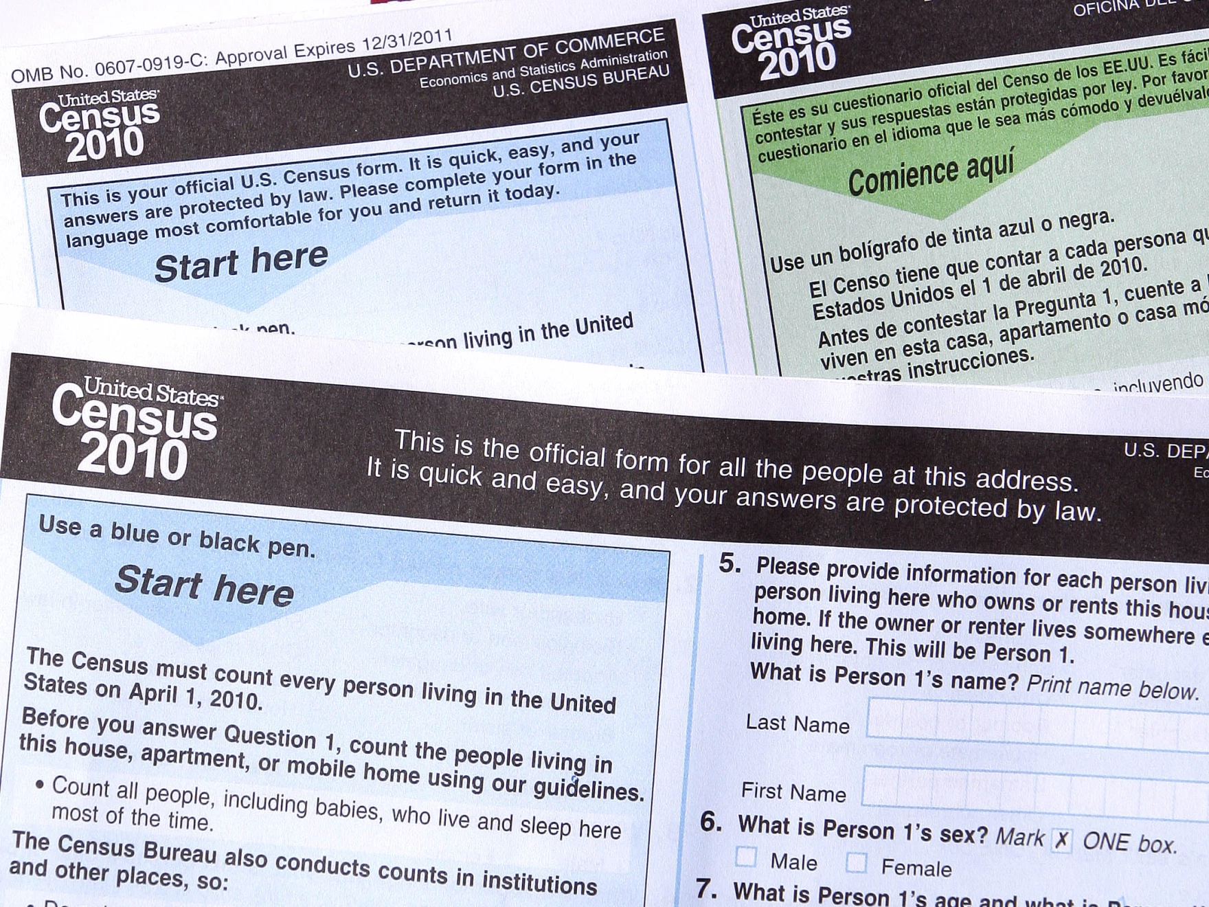
Challenges with Census Data
• Data Quality: Missing or inaccurate entries can degrade model performance.
• Class Imbalance: E.g., fewer high-earning individuals.
• High Dimensionality: Numerous features can complicate the modeling process.
• Privacy & Ethics: Sensitive personal data must be handled responsibly.

Slide 5
Workflow
Exploratory Data Analysis I
Data Cleanup
Feature Engineering
Exploratory Data Analysis II
Preprocessing
Training Models
Testing Models
Evaluating Model Performances
Optimizing Models
Final Model Selection
Evaluating Final Model Performance
One Hot Encoding

Slide 6
Raw Census Data
Data has 199,523 records of 40 unique variables
# | Column | Non-Null | Count | Dtype
0 | age | 199523 | non-null | int64
1 | class_of_worker | 199523 | non-null | object
2 | detailed_industry_recode | 199523 | non-null | int64
3 | detailed_occupation_recode | 199523 | non-null | int64
4 | education | 199523 | non-null | object
5 | wage_per_hour | 199523 | non-null | int64
6 | enroll_in_edu_inst_last_wk | 199523 | non-null | object
7 | marital_stat | 199523 | non-null | object
8 | major_industry_code | 199523 | non-null | object
9 | major_occupation_code | 199523 | non-null | object
10 | race | 199523 | non-null | object
11 | hispanic_origin | 199523 | non-null | object
12 | sex | 199523 | non-null | object
13 | member_of_a_labor_union | 199523 | non-null | object
14 | reason_for_unemployment | 199523 | non-null | object
15 | full_or_part_time_employment_stat | 199523 | non-null | object
16 | capital_gains | 199523 | non-null | int64
17 | capital_losses | 199523 | non-null | int64
18 | dividends_from_stocks | 199523 | non-null | int64
19 | tax_filer_stat | 199523 | non-null | object
20 | region_of_previous_residence | 199523 | non-null | object
# | Column | Non-Null | Count | Dtype
21 | state_of_previous_residence | 199523 | non-null | object
22 | detailed_household_and_family_stat | 199523 | non-null | object
23 | detailed_household_summary_in_household | 199523 | non-null | object
24 | instance_weight | 199523 | non-null | float64
25 | migration_code-change_in_msa | 199523 | non-null | object
26 | migration_code-change_in_reg | 199523 | non-null | object
27 | migration_code-move_within_reg | 199523 | non-null | object
28 | live_in_this_house_1_year_ago | 199523 | non-null | object
29 | migration_prev_res_in_sunbelt | 199523 | non-null | object
30 | num_persons_worked_for_employer | 199523 | non-null | int64
31 | family_members_under_18 | 199523 | non-null | object
32 | country_of_birth_father | 199523 | non-null | object
33 | country_of_birth_mother | 199523 | non-null | object
34 | country_of_birth_self | 199523 | non-null | object
35 | citizenship | 199523 | non-null | object
36 | own_business_or_self_employed | 199523 | non-null | int64
37 | fill_inc_questionnaire_for_veteran's_admin | 199523 | non-null | object
38 | veterans_benefits | 199523 | non-null | int64
39 | weeks_worked_in_year | 199523 | non-null | int64
40 | year | 199523 | non-null | int64
41 | target | 199523 | non-null | object

Slide 7
Data Prep
Data Cleanup
Add column names from metadata labels
Convert the following values to NA according to the metadata:
'Not in universe', 'Not in universe or children', 'Do not know', '?', 'Not identifiable', 'Not in universe under 1 year old’
Trim trailing or leading whitespaces from all variables
Replace 0 with NA for several variables as per metadata
Feature Engineering
new_class_of_worker: classifies as private or government employee
moved: did person move within/outside their region? Yes or no
both_parents_present: both mother and father present?
american_father: does the person have an American father?
american_mother: does the person have an American mother?
One Hot Encoding
Discrete variables:
Apply one hot encoding while preserving NA records
'hispanic_origin'
'race'
'region_of_previous_residence'
'new_education'

Slide 8
Prepped Census Data
Data has 199,523 records of 63 unique variables
# | Column | Non-Null | Count | Dtype
0 | age | 199523 | non-null | int64
1 | class_of_worker | 99278 | non-null | object
2 | detailed_industry_recode | 199523 | non-null | int64
3 | detailed_occupation_recode | 199523 | non-null | int64
4 | education | 199523 | non-null | object
5 | wage_per_hour | 11304 | non-null | float64
6 | enroll_in_edu_inst_last_wk | 12580 | non-null | object
7 | marital_stat | 199523 | non-null | object
8 | major_industry_code | 98839 | non-null | object
9 | major_occupation_code | 98839 | non-null | object
10 | sex | 199523 | non-null | object
11 | member_of_a_labor_union | 19064 | non-null | object
12 | reason_for_unemployment | 6070 | non-null | object
13 | full_or_part_time_employment_stat | 199523 | non-null | object
14 | capital_gains | 7379 | non-null | float64
15 | capital_losses | 3906 | non-null | float64
16 | dividends_from_stocks | 21141 | non-null | float64
17 | tax_filer_stat | 199523 | non-null | object
18 | state_of_previous_residence | 15065 | non-null | object
19 | detailed_household_and_family_stat | 199523 | non-null | object
20 | detailed_household_summary_in_household | 199523 | non-null | object
21 | migration_code-change_in_msa | 97881 | non-null | object
22 | migration_code-change_in_reg | 98311 | non-null | object
23 | migration_code-move_within_reg | 98311 | non-null | object
24 | live_in_this_house_1_year_ago | 98311 | non-null | object
25 | migration_prev_res_in_sunbelt | 15773 | non-null | object
26 | num_persons_worked_for_employer | 103540 | non-null | float64
27 | family_members_under_18 | 55291 | non-null | object
28 | country_of_birth_father | 192810 | non-null | object
29 | country_of_birth_mother | 193404 | non-null | object
30 | country_of_birth_self | 196130 | non-null | object
31 | citizenship | 199523 | non-null | object
# | Column | Non-Null | Count | Dtype
32 | own_business_or_self_employed | 18851 | non-null | object
33 | fill_inc_questionnaire_for_veteran's_admin | 1984 | non-null | object
34 | veterans_benefits | 199523 | non-null | int64
35 | weeks_worked_in_year | 103540 | non-null | float64
36 | year | 199523 | non-null | category
37 | target | 199523 | non-null | object
38 | new_class_of_worker | 98674 | non-null | object
39 | moved | 98311 | non-null | object
40 | both_parents_present | 55291 | non-null | object
41 | american_father | 192810 | non-null | object
42 | american_mother | 193404 | non-null | object
43 | new_education_Bachelors | 199523 | non-null | float64
44 | new_education_Doctorate | 199523 | non-null | float64
45 | new_education_Masters | 199523 | non-null | float64
46 | new_education_NoDegree | 199523 | non-null | float64
47 | new_education_ProfSchool | 199523 | non-null | float64
48 | race_Asian or Pacific Islander | 199523 | non-null | float64
49 | race_Black | 199523 | non-null | float64
50 | race_Other | 199523 | non-null | float64
51 | race_White | 199523 | non-null | float64
52 | hispanic_origin_Central or South American | 198343 | non-null | float64
53 | hispanic_origin_Chicano | 198343 | non-null | float64
54 | hispanic_origin_Cuban | 198343 | non-null | float64
55 | hispanic_origin_Mexican (Mexicano) | 198343 | non-null | float64
56 | hispanic_origin_Mexican-American | 198343 | non-null | float64
57 | hispanic_origin_Other Spanish | 198343 | non-null | float64
58 | hispanic_origin_Puerto Rican | 198343 | non-null | float64
59 | region_of_previous_residence_Midwest | 15773 | non-null | float64
60 | region_of_previous_residence_Northeast | 15773 | non-null | float64
61 | region_of_previous_residence_South | 15773 | non-null | float64
62 | region_of_previous_residence_West | 15773 | non-null | float64

Slide 9

Exploratory Data Analysis II

Slide 10
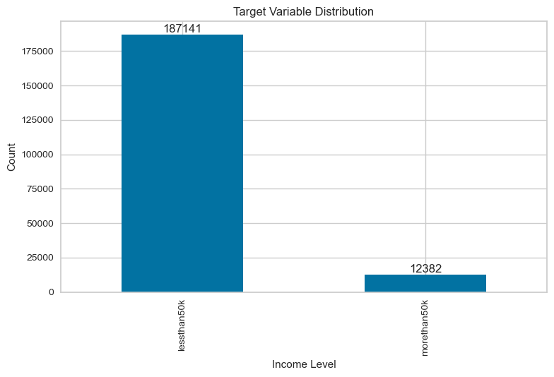
Exploratory Data Analysis II

Slide 11

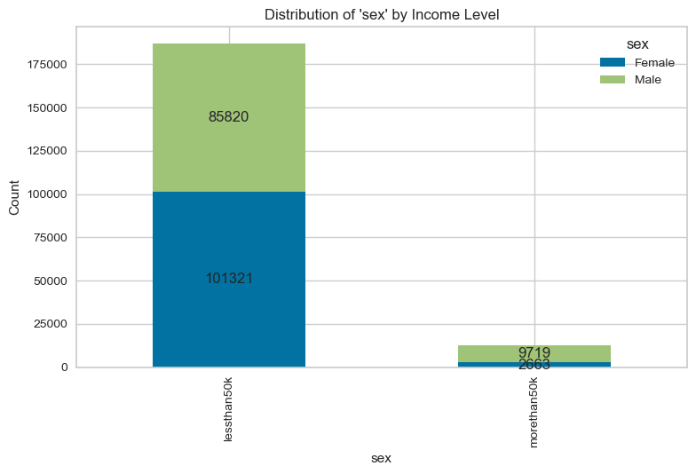
54% women in the "less than 50k" group compared to 21% in the "more than 50k" group
46% men in the "less than 50k" group compared to 78% in the "more than 50k" group

Slide 12
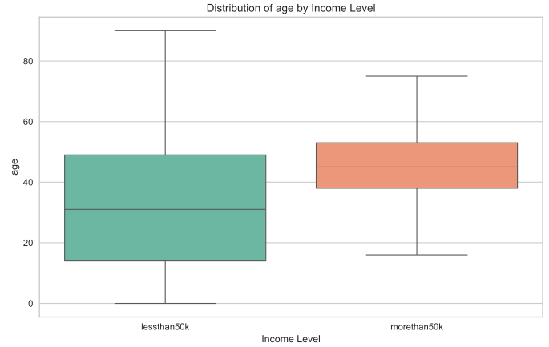
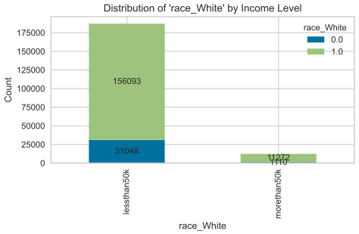
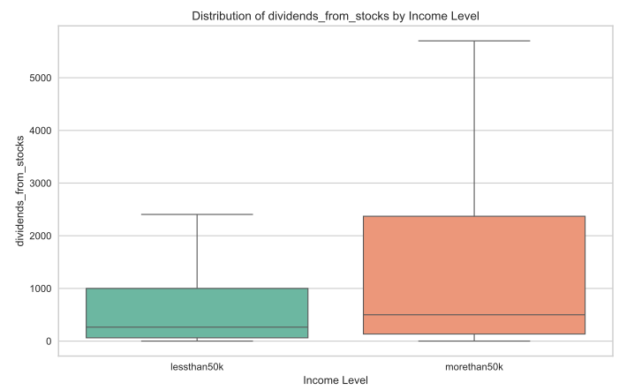
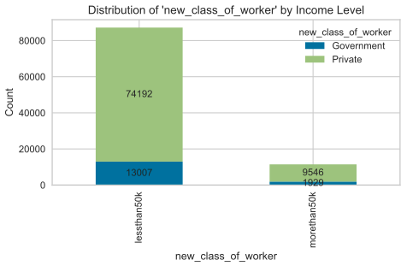

Slide 13
Modeling Data
Data used in modeling: 199,523 records of 36 variables
# | Column | Non-Null | Count | Dtype
0 | new_class_of_worker | 98674 | non-null | object
1 | race_Black | 199523 | non-null | float64
2 | american_father | 192810 | non-null | object
3 | region_of_previous_residence_Northeast | 15773 | non-null | float64
4 | new_education_Bachelors | 199523 | non-null | float64
5 | year | 199523 | non-null | category
6 | new_education_Masters | 199523 | non-null | float64
7 | race_Asian or Pacific Islander | 199523 | non-null | float64
8 | live_in_this_house_1_year_ago | 98311 | non-null | object
9 | hispanic_origin_Central or South American | 198343 | non-null | float64
10 | region_of_previous_residence_Midwest | 15773 | non-null | float64
11 | race_Other | 199523 | non-null | float64
12 | moved | 98311 | non-null | object
13 | new_education_ProfSchool | 199523 | non-null | float64
14 | region_of_previous_residence_West | 15773 | non-null | float64
15 | sex | 199523 | non-null | object
16 | new_education_NoDegree | 199523 | non-null | float64
17 | region_of_previous_residence_South | 15773 | non-null | float64
# | Column | Non-Null | Count | Dtype
18 | american_mother | 193404 | non-null | object
19 | race_White | 199523 | non-null | float64
20 | hispanic_origin_Mexican (Mexicano) | 198343 | non-null | float64
21 | hispanic_origin_Puerto Rican | 198343 | non-null | float64
22 | migration_prev_res_in_sunbelt | 15773 | non-null | object
23 | new_education_Doctorate | 199523 | non-null | float64
24 | hispanic_origin_Chicano | 198343 | non-null | float64
25 | member_of_a_labor_union | 19064 | non-null | object
26 | hispanic_origin_Mexican-American | 198343 | non-null | float64
27 | hispanic_origin_Cuban | 198343 | non-null | float64
28 | hispanic_origin_Other Spanish | 198343 | non-null | float64
29 | age | 199523 | non-null | int64
30 | wage_per_hour | 11304 | non-null | float64
31 | capital_gains | 7379 | non-null | float64
32 | capital_losses | 3906 | non-null | float64
33 | dividends_from_stocks | 21141 | non-null | float64
34 | weeks_worked_in_year | 103540 | non-null | float64
35 | target | 199523 | non-null | object

Slide 14
SMOTE Effect

Slide 15
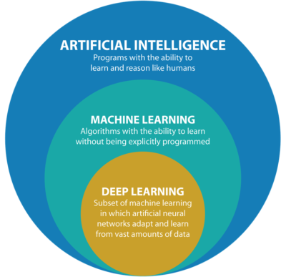
What is Machine Learning?
Machine Learning (ML) is an AI subfield where systems learn patterns from data rather than relying on explicit programming.
ML techniques can uncover complex relationships, enabling predictions and data-driven decisions.

Slide 16
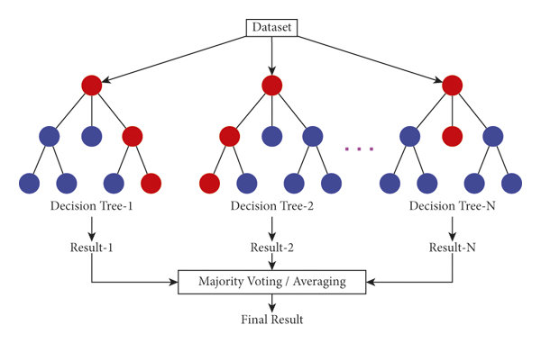
Random Forest
Ensemble of Decision Trees – Random Forest is an ensemble technique that aggregates many individual trees, reducing overfitting and improving predictive performance.
Random Subset of Features – Each tree is trained on a random selection of features, promoting diversity and robustness.
Handles Complex Data – Particularly effective on high-dimensional data like census records with numerous attributes.
Predictive Stability – By averaging multiple trees, Random Forest often delivers more consistent and reliable outcomes than a single decision tree.

Slide 17

LightGBM
High Performance with Large Data – Light Gradient Boosting Machine is designed for speed, efficiency, and large-scale data, making it ideal for extensive census-based features.
Gradient Boosting Framework – It refines predictions iteratively, boosting overall accuracy by building on previous model errors.
Leaf-Wise Tree Growth – Rather than expanding level by level, LightGBM splits leaves that most reduce error, improving precision for complex datasets.
Highly Scalable – Works well in distributed and parallel environments, enabling quicker experimentation with census data.

Slide 18


XGBoost
Optimized Library – Fast, efficient gradient boosting for complex census data.
Competition Champion – Consistently tops ML contest leaderboards.
Handles Tabular Data Effectively – Well-suited to complex, high-dimensional datasets like census records.
Extensive Hyperparameter Control – Provides multiple tuning parameters to balance accuracy, speed, and model complexity.

Slide 19
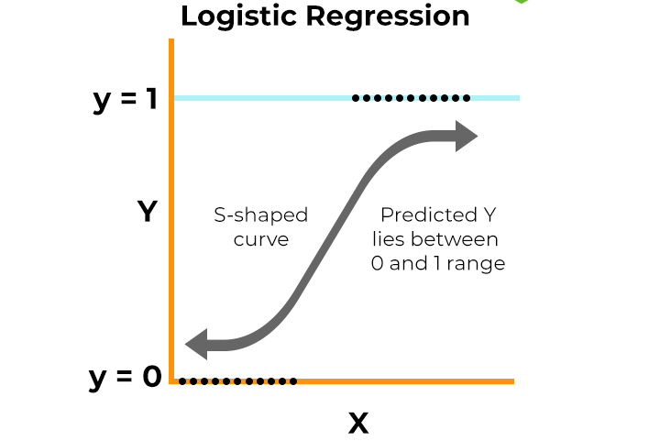
Logistic Regression
Interpretable Coefficients – Reveals how each census feature impacts the probability of earning >$50K.
Straightforward Binary Classification – Suited for “above or below” income thresholds.
Probabilistic Output – Generates likelihood estimates, not just class labels.
Fast & Simple – Quick to train and easy to implement on various dataset sizes.

Slide 20
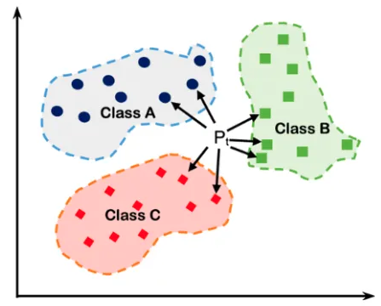
K Nearest Neighbors
KNN is a non-parametric algorithm for classification and regression
Lazy learner, storing data and making predictions based on neighbors
Choice of K crucial—small K can overfit, large K can underfit
Uses distance metrics like Euclidean

Slide 21
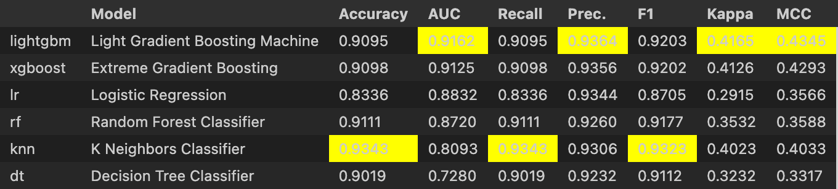
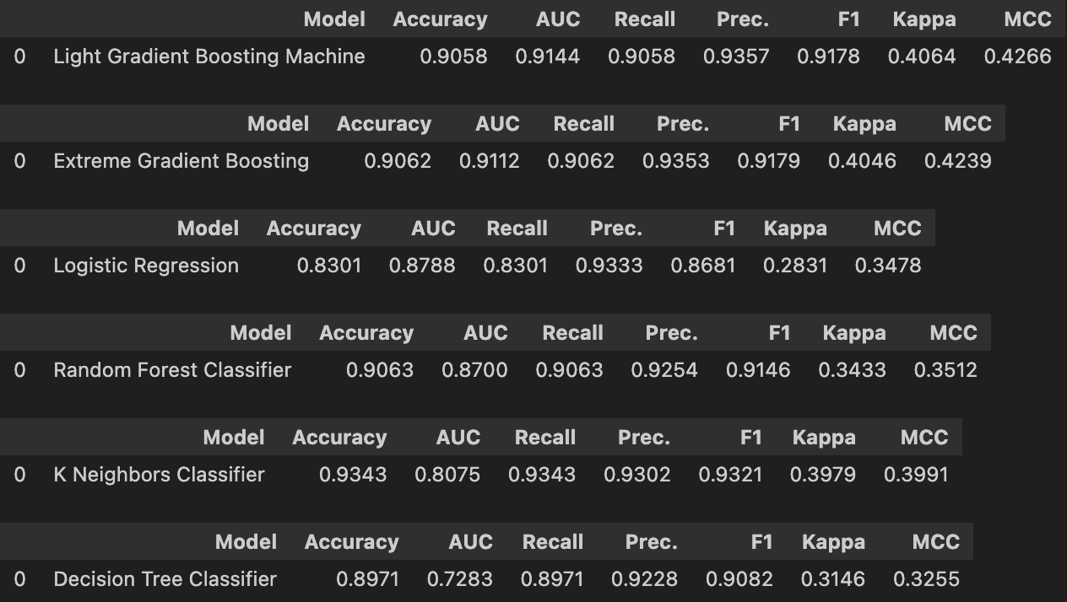
Results
Training Set Metrics
Testing Set Metrics

Slide 22
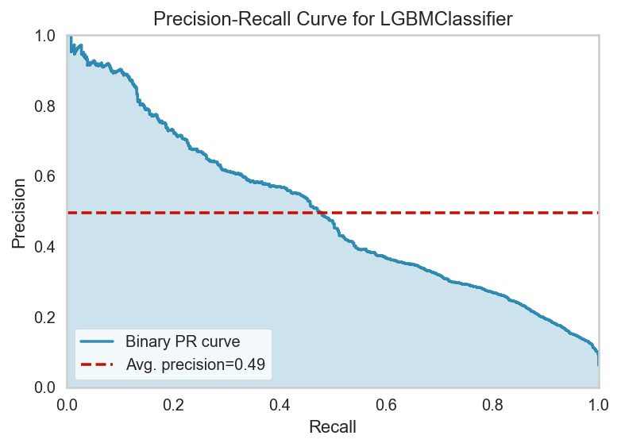
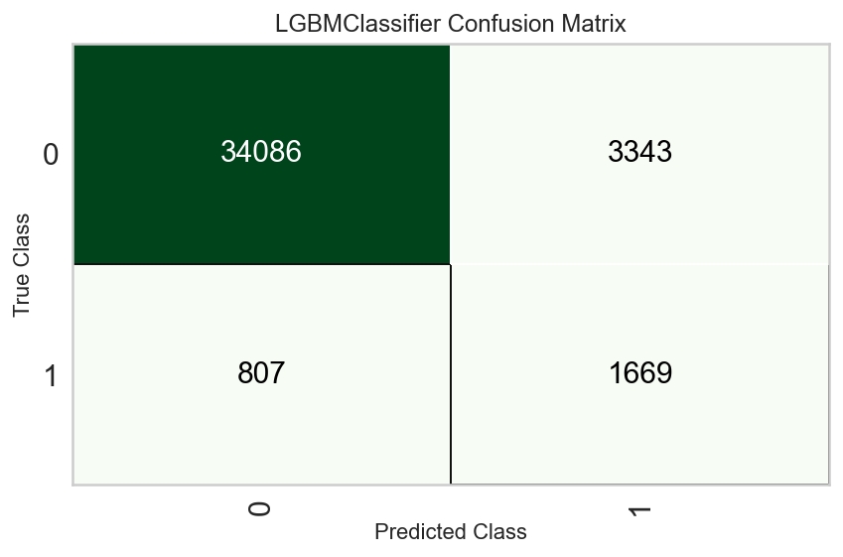
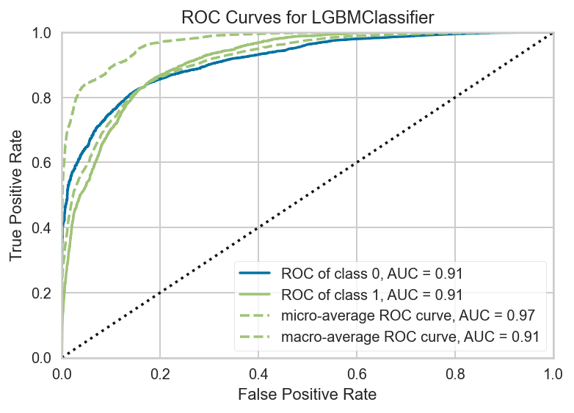
Results

Slide 23
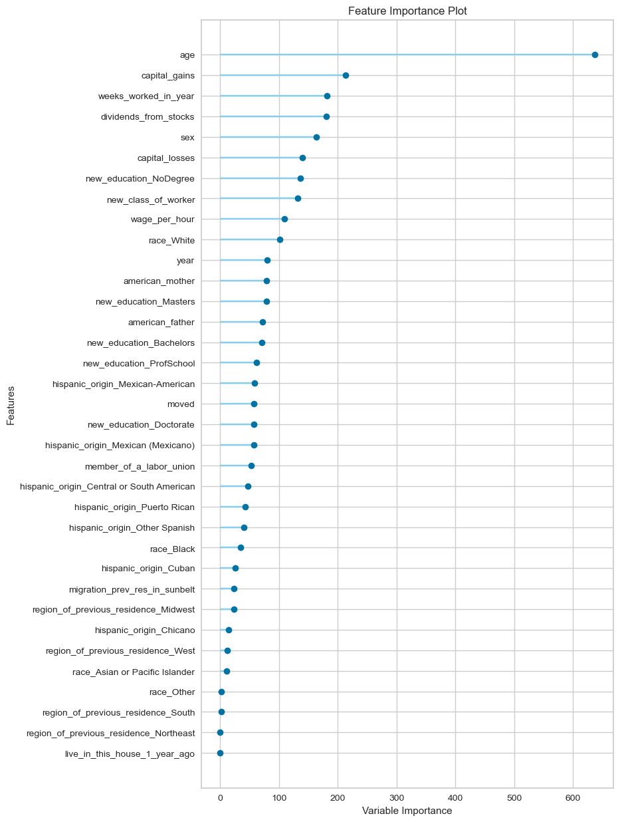
Feature Importances

Slide 24
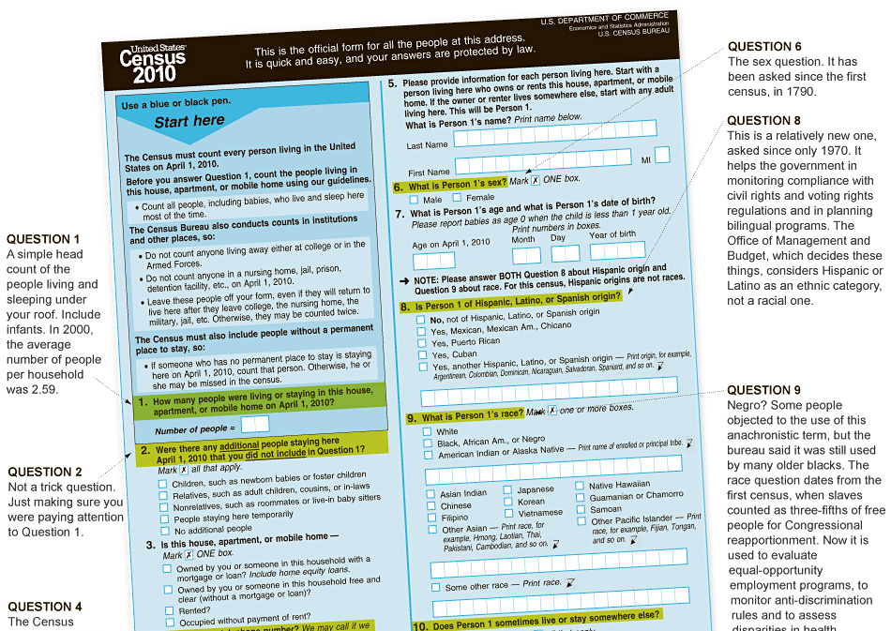
Conclusion
Census data is a rich resource for income-level prediction.
Each model brings unique strengths:
Random Forest: Ensemble of decision trees that reduces overfitting.
LightGBM: Rapid training and scalable to large datasets. XGBoost: Highly optimized for speed and performance on tabular data.
Logistic Regression: Simple, transparent, interpretable model.
KNN: Simple, non-parametric, lazy learner, fast.
Choosing the right model depends on data size, complexity, and interpretability needs.
Combined with domain expertise, these techniques can yield meaningful insights into income distribution and inform policy.

